Slide 1
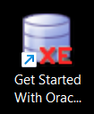
Welcome to Database Management System “Project Presentation”

Slide 2
Project Title: Mini Social Media
"Built on Oracle Database 11g Express Edition"

Slide 3
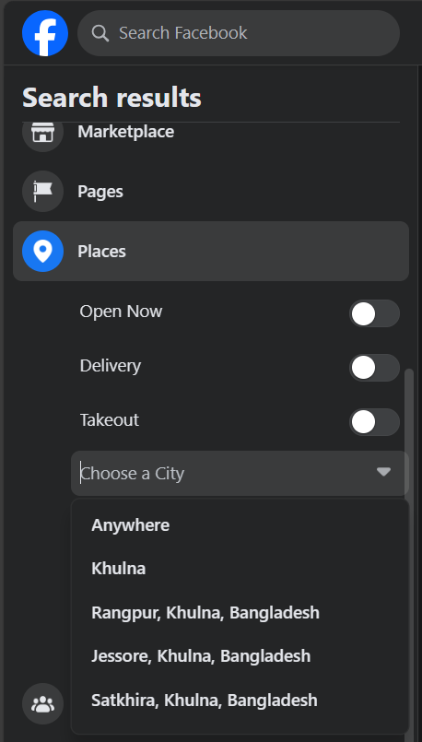
Practical Example

Slide 4
Objectives
The objective of the "Mini Social Media" project is to design and implement a simplified social media platform using the Oracle Database Management System (DBMS).

Slide 5
Key-features
Create and manage user profiles with personal information and profile pictures.
Connect with other users by sending and accepting friend requests.
Post and view text-based messages, photos, and videos.
Like, comment on, and share posts from friends and connections.
Securely store user data, including personal information and posts, in a relational database.

Slide 6
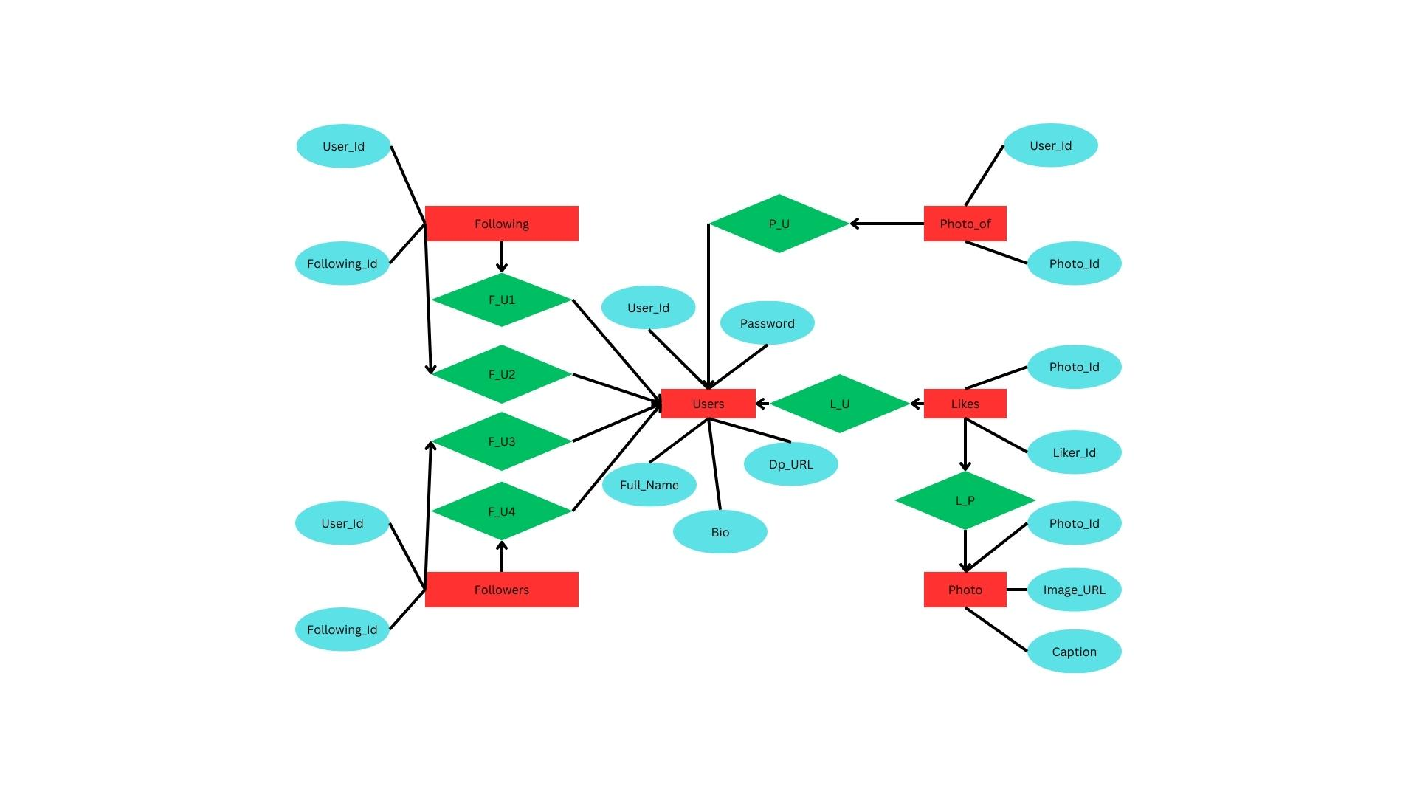

Slide 7
Let us Dive into Some Queries

Slide 8
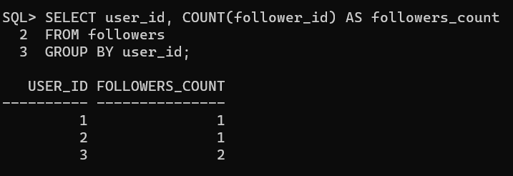
Query 1
Retrieve the number of followers for each user:
SELECT user_id, COUNT(follower_id) AS followers_count
FROM followers
GROUP BY user_id;

Slide 9
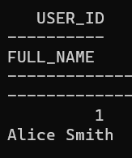
Query 2
Retrieve all followers for a specific user:
SELECT followers.user_id, users.full_name
FROM followers
JOIN users ON followers.follower_id = users.user_id
WHERE followers.user_id = 1;

Slide 10
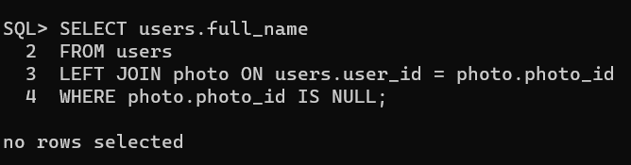
Query 3
Retrieve users who have not posted any photos:
SELECT users.full_name
FROM users
LEFT JOIN photo ON users.user_id = photo.photo_id
WHERE photo.photo_id IS NULL;

Slide 11
The "Mini Social Media" provides a platform for users to
connect, share, and interact,
emphasizing the use of the Oracle DBMS
to ensure data integrity and security.

Slide 12
Thank You

